Slide 1


SAP UI5 & FIORI with OData TRAINING
Anubhav Oberoy
Day – 4

Slide 2

Agenda – Day 4
Introduction to NodeJS
NPM – Node Package Manager
Creating a server using NodeJS
Using external libraries in the Project
SAP UI5
Under the hood of SAP UI5
Introduction to the MVC Architecture
Components of a UI5 Application
Creating our First UI5 Application
Introduction to the SAP UI5 SDK

Slide 3
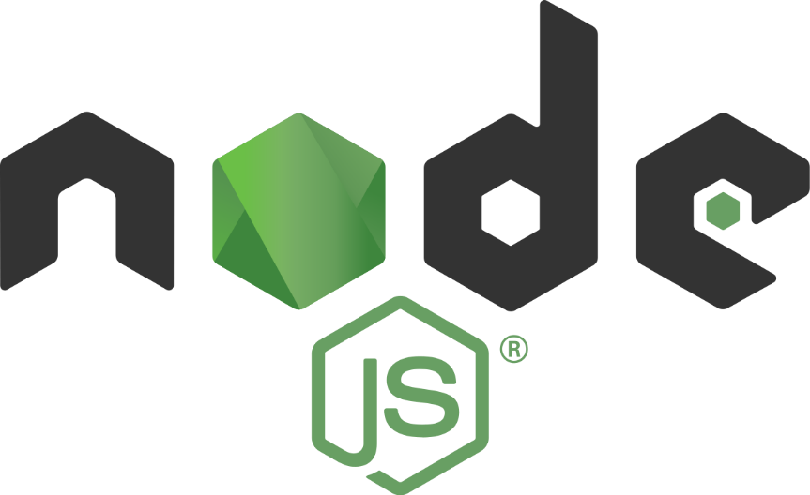
Introduction to NodeJS
Node JS is an open-source, cross platform, JavaScript runtime environment and used to execute JavaScript on Server Side.
Node JS is a framework which allows us to run JS code outside browser. The main benefit is that a development do not need to learn multiple programming languages. If we know JS, we can code both client and server side in same language.
Node JS is also a great web framework for beginners because it works great for data intensive applications like streaming, gaming and real time apps. It leverage the power of JS’s Asynchronous no blocking IO.
Application of Node JS
Build Backend Application Logic
Host a Web Server (express)
Send Emails
DB lookup
Automation
Output to the user
Use its eco-system like PDF, EXCEL, EMAIL…
Install NodeJS in our system form here https://nodejs.org/en/, if you using bas, you do not need to install as BAS already has NodeJS preinstalled.
If we want to achieve something, this something was already achieved by someone, somewhere else in the world, they have already published it as a node module which we can import and reuse. We get ready-to-use code for consumption for speedy development. https://npmjs.com

Slide 4

NPM – Node Package Manager
Node Package Manager (NPM) is a command line tool that installs, updates or uninstalls Node.js packages in your application. It is also an online repository for open-source Node.js packages. The node community around the world creates useful modules and publishes them as packages in this repository.
npm is the world's largest Software Registry.
The registry contains over 800,000 code packages.
Open-source developers use npm to share software.
Many organizations also use npm to manage private development.
npm is installed with Node.js
NPM is included with Node.js installation. After you install Node.js, verify NPM installation by writing the following command in terminal or command prompt ‘npm –v’
https://www.npmjs.com/

Slide 5
Steps to create a Fresh NodeJS Project
Run a command called npm init – Create a new Nodejs project
Answer some simple questions like project name, starring file, author, version, description, …
We can mention the starring file of the project. We use myfirstnode.js as starring file, but in most of the cases we use index.js to follow the best practices.
We can just add some code to this file with all the modules
Then we run npm install module_name --save OR npm install module_name --save-dev to add a module to our project
To run the project, we can use the ‘node .’ command in the terminal.
npmjs
Steps to use an external library using node js
Find the library (module) of your purpose on npmjs and check its documentation
Use require statement
We have downloaded this library in local project – npm install MODULENAME
We need to add all the required module dependencies inside package.json file
We only ship our project to other developers/system
In the new system, we run npm install It will read all required modules and
Automatically download those dependencies.
npm install
Laptop
Project+
Module
Laptop
Project

Slide 6
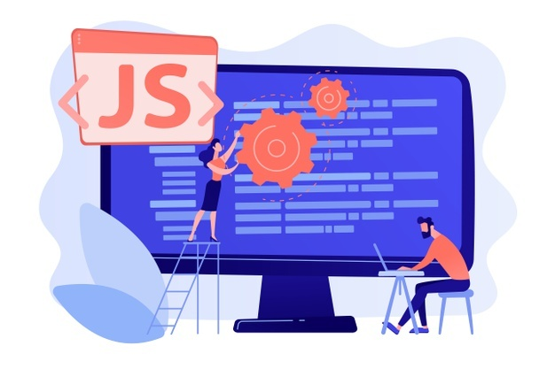
Exercise: First NodeJS
In this exercise we will see how to create a server using the NodeJS.
We will try to get some date using the NodeJS server in the browser.
We will also integrate an html page with the NodeJS.
To initialize a NodeJS project we need to run npm init command in terminal.
Exercise code/resource:
myfirstnode.js
reuse.js

Slide 7
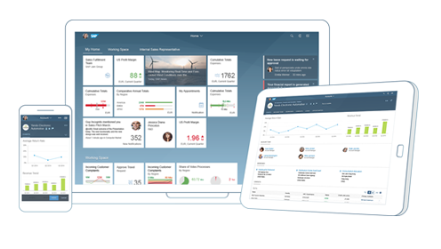

What is SAP UI5?
SAPUI5 (SAP user interface for HTML5) is a collection of libraries that you can use to build desktop and mobile applications that run in a browser. With the SAPUI5 JavaScript toolkit, you can create web applications using HTML5 web development standards.
SAP UI5 is a framework which is used to develop Responsive web applications to run on any platform, any browser and any OS.
Responsive
App which can adapt itself according the different devices
Framework
It’s a collection of Libraries.
Library
Collection of classes.
Classes
Collection of methods, Attributes, Events
Software Innovation
Hardware Innovation
Trainer: Anubhav Oberoy & Nishan

Slide 8
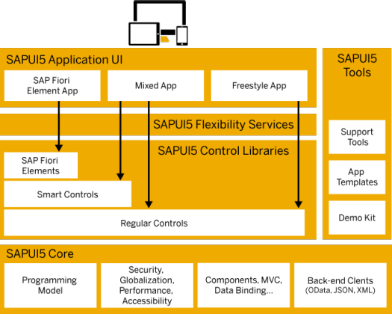
Under the Hood of SAP UI5
SAPUI5 simplifies web application development. A variety of UI controls, ranging from basic elements to complex UI patterns, can be combined for an appealing layout. All UI controls leverage a consistent design language and coherent UX patterns. SAPUI5 flexibility services let you easily adapt the UI of an app and store the changes in a layered repository.

Slide 9
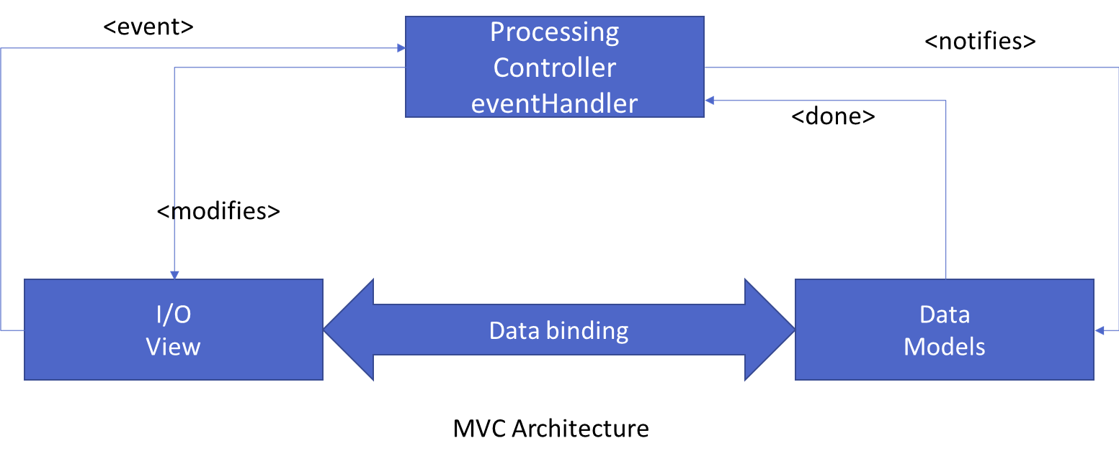
Introduction to MVC Architecture
MVC stands for Model, View, Controller.
Model:- The model component is a freely composed class that will keep the application data and do manipulations on it. All database accesses are done within the model.
View:- The View is responsible for defining the user interface to users. When a user sends a requests from his device, the view is responsible for data view as per the request submitted.
Controller:- The Controller is used to control the data and view events as per user interaction by updating the view and model.

Slide 10
Components of UI5 Application
The UI5 framework is built on top of open standards like HTML5, CSS, JS, and jQuery. We use MVC architecture to create applications using SAPUI5.
BAS
App
Developer
SAPUI5 Runtime Component
HTML+CSS+JS
sap.m
sap.ui.comp
sap.ui.table
sap.ui.layout
Renderer
sap.ui.core
sap.ui.unified
sap.ui.core.mvc
HTML5
CSS
JS
jQuery

Slide 11
Creating first UI5 Application
Now we will create our first UI5 application.
In this application we are going to add a simple button provided in SAP UI5.
When the button is pressed it shows an alert popup at the top.
Steps to Create a UI5 app
Start with a project folder and all the productive files inside the webapp folder
Initialize a node project using (npm init)
Add a manifest.json file inside UI5 project (inside webapp) which talks about our project properties (sap.app, sap.ui, sap.ui5)
Mention that this is a UI5 type project hence we run a command called ui5 init
Create an HTML file index.html inside webapp folder.
Create HTML Head and body
Add the Bootstrap code for HTML, load sap ui5 from CDN https://sapui5.hana.ondemand.com/resources/sap-ui-core.js
Along with step 2, we will specify theme, library, and the path where all our project resources are present
Create object of our first view
Place this view in the body
Now create a view/Our view and in this view, we will add the control (JS View), when we implement view, we need to add 2 methods createContent and getControllerName
Create a controller (like a class) for this view, we can also put a constructor method onInit
Execute project using ui5 serve command

Slide 12

Exercise: First UI5 Project
Now we will create our first ui5 application by following the steps mentioned in the previous slide.
Exercise code/Resource:
index.html
MyView.controller.js
MyView.view.xml
mainfest.json

Slide 13
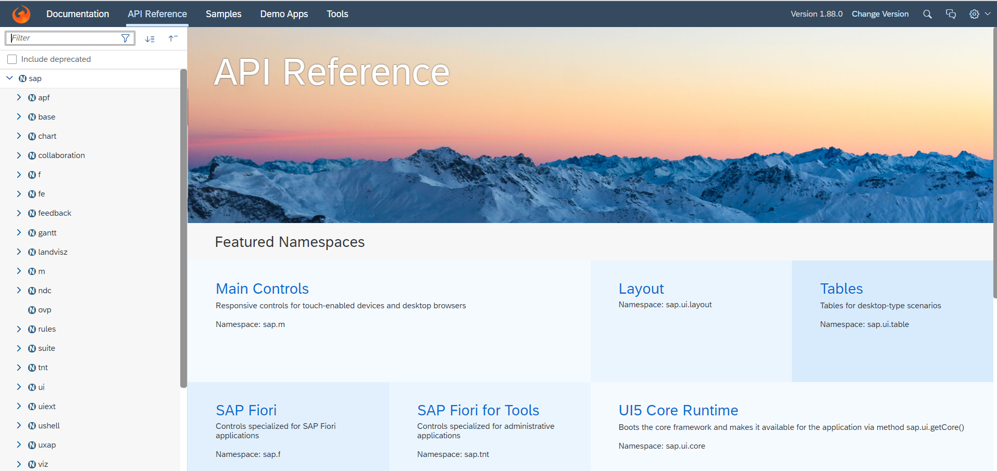
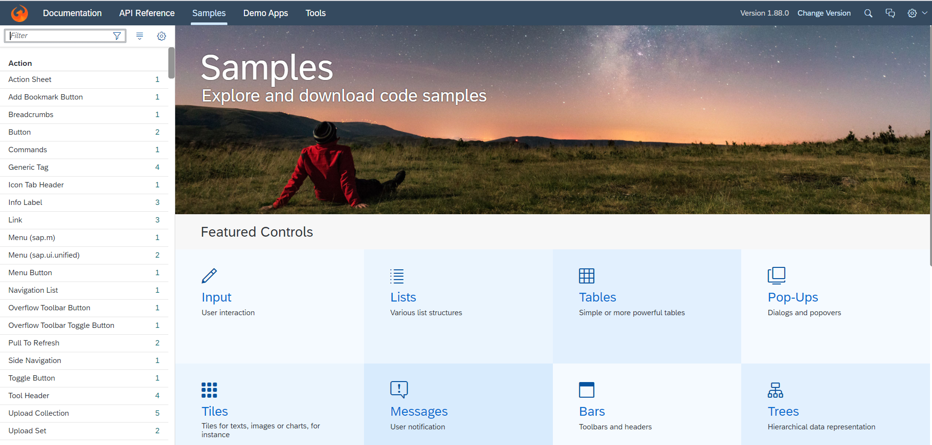
Introduction to UI5 SDK
Documentation of SAP UI5 is available at the SAPUI5 Software Development Kit.
We can access the SAP UI5 API’s at the Documentation page of SAP UI5 or you can use the link to go to sap’s API screen - LINK
We can directly search the required api’s on the SDK.
SDK contains the sample of all the controls which we can use in UI5
SAP UI5 API reference screen
SAP UI5 Sample reference screen

Slide 14
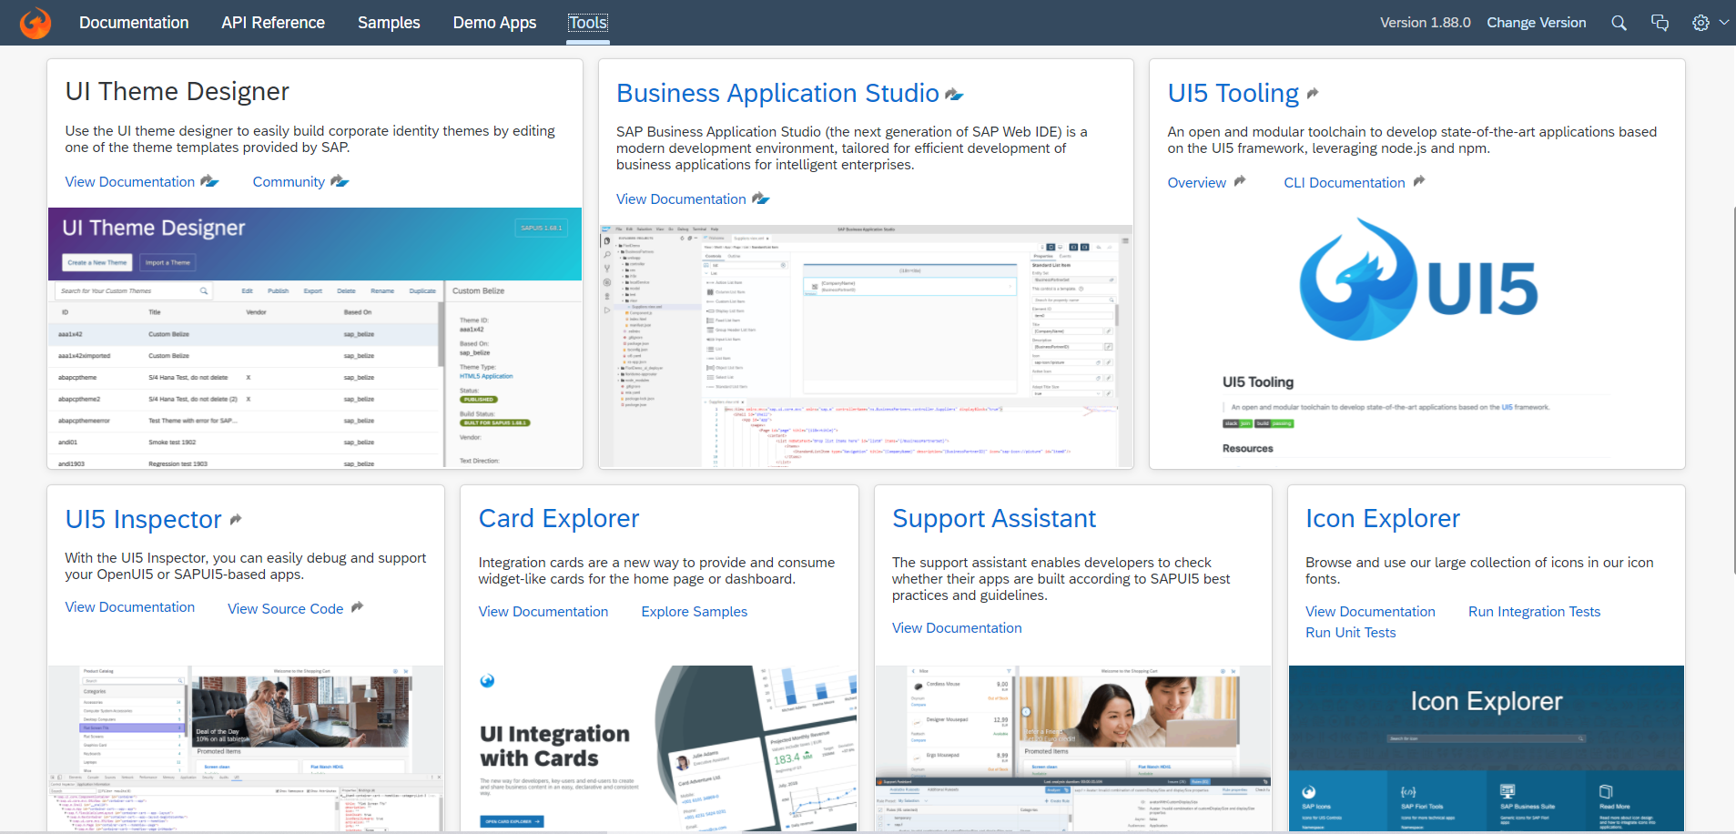
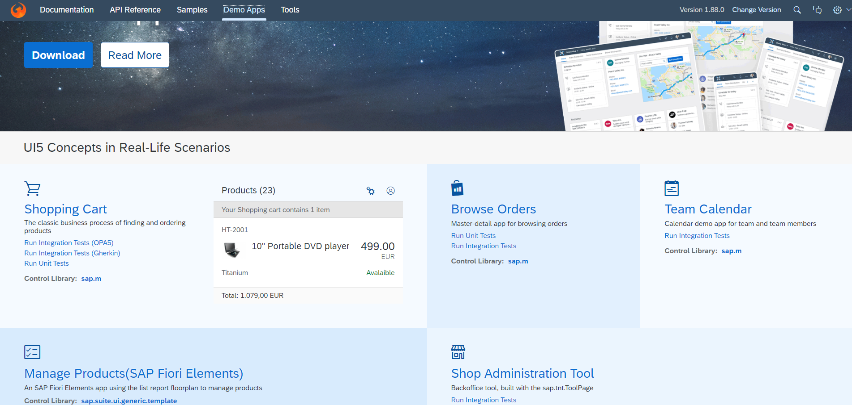
UI5 SDK continues…
UI5 SDK contains tools to make the development smooth for the developers.
It has UI5 icon packs which can be directly accessed for the UI5 SDK’s Tool Screen (Link).
SAP UI5 SDK provides us the demo application, So we can get an idea about how to create different type of applications using UI5 controls
UI5 SDK Tools Screen
UI5 SDK Demo Apps Screen

Slide 15
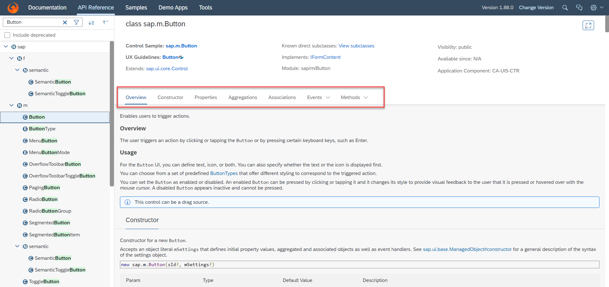
UI5 SDK continues…
When we search and open any API we see a screen similar to one which is shown below.
Every API contains different kind of:
Properties,
Aggregations,
Associations,
Events,
Methods

Slide 16

End of Day 4

Slide 17

Questions

Slide 18

Anubhav Oberoy

Slide 19


We’re committed to empower you to be
Most Desirable Resource
through powerful training solutions.
We build the workforce of the future.
250+
Corporate Clients
30,000+
Learners Trained
25000+
Learners Placed
FREE WEBINARS
Sign up for free webinars with industry experts every fortnight!
Enroll Now!
Contact us today!
https://anubhavtrainings.com/

Slide 20




More from AnubhavTrainings.com

Slide 21
Title
Content

